Slide 1

Real Time Competitor Strategy
AI app

Slide 2
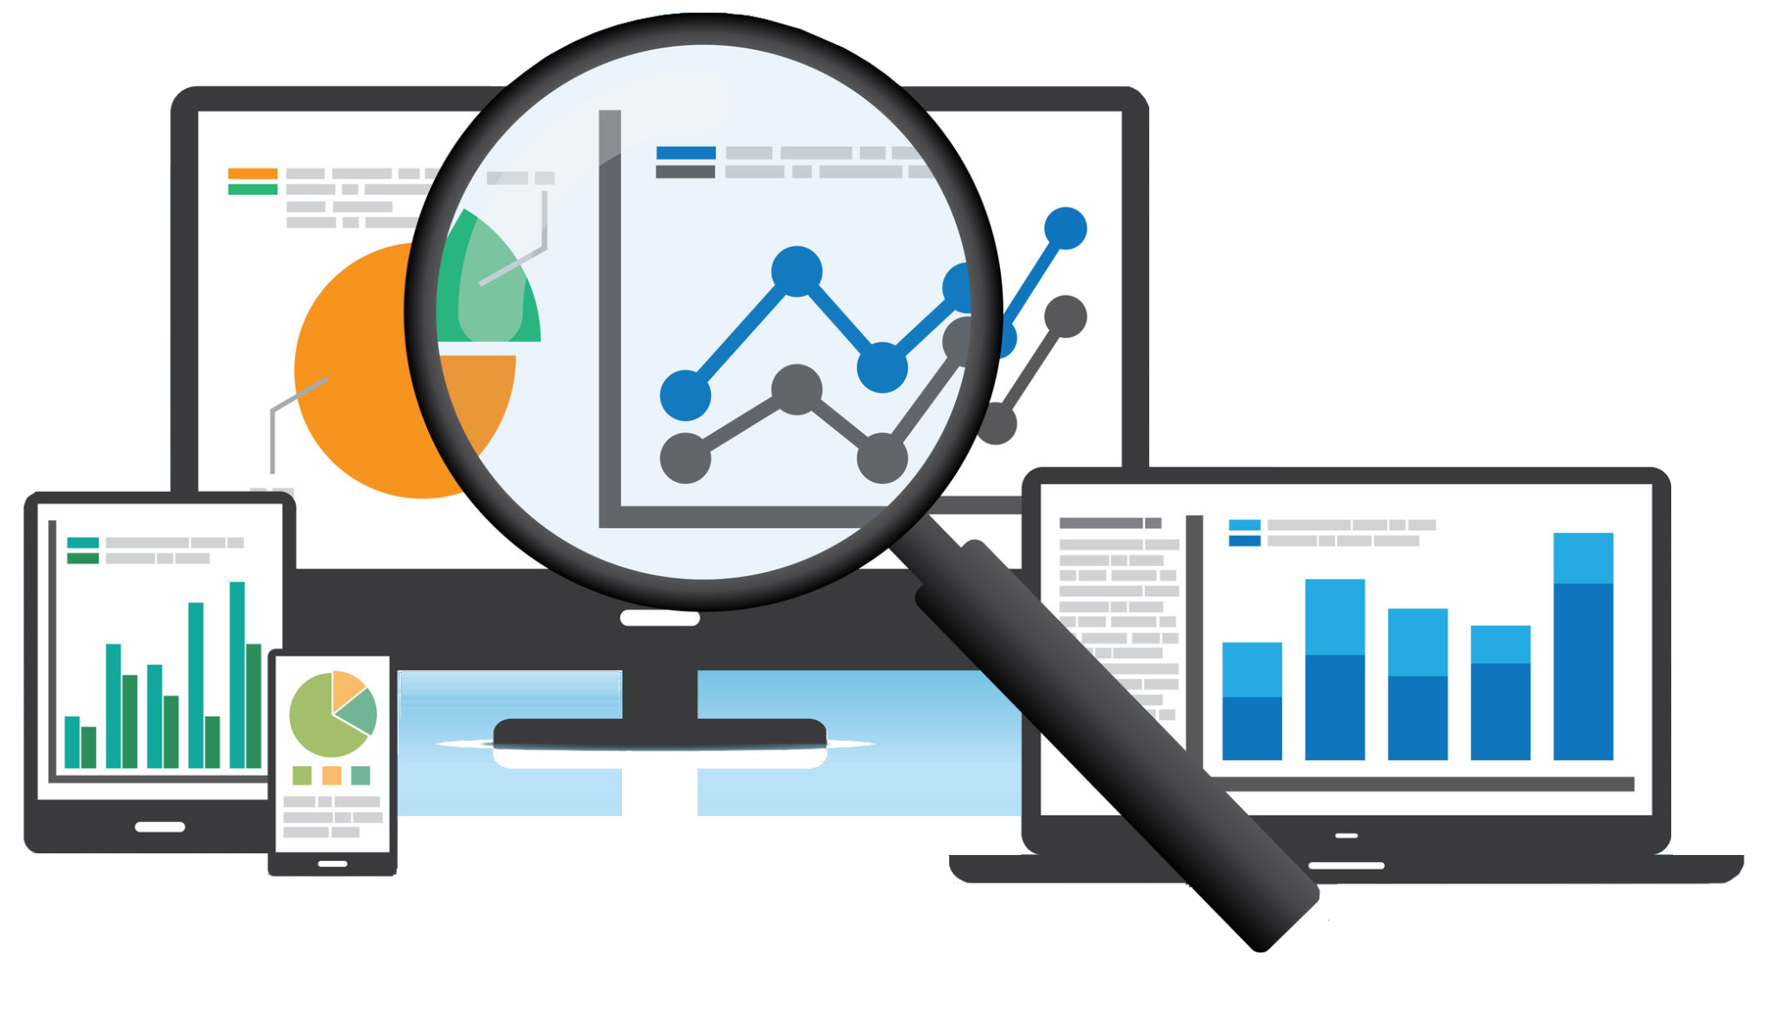
What is Real Time Competitor Strategy AI app?
A “Real-Time Competitor Strategy AI app” analyzes competitor activities in real time, providing insights into their pricing, marketing, and sales strategies. It uses AI to monitor competitor websites, social media, and other data sources, helping businesses adapt quickly and stay ahead in the market with data-driven strategies.

Slide 3
Why this Project?
Competitive Advantage: The AI app provides real-time insights into competitor strategies, helping businesses stay ahead by adapting quickly to market changes.
Data-Driven Decisions: It uses AI to analyze competitor data, enabling businesses to make informed decisions on pricing, marketing, and product positioning.
Enhanced Strategy Optimization: By monitoring competitor actions, the app helps refine business strategies, improving overall performance and market positioning.

Slide 4


Our Goals
Vision: To empower businesses with real-time, AI-driven insights that enable smarter, data-driven decisions, helping them stay ahead of competitors and lead in the market.
Mission: To provide businesses with cutting-edge AI technology that monitors and analyzes competitor strategies, offering actionable insights for continuous improvement and strategic growth in a dynamic market.

Slide 5

Core Capabilities
ARIMA Forecasting: Uses the ARIMA model to predict future competitor trends based on historical data.
AI Analysis: Analyzes competitor strategies, offering insights on pricing and marketing.
Actionable Insights: Provides clear, data-driven reports for informed decision-making.
Trend Forecasting & Alerts: Predicts market trends and sends real-time notifications for quick action.

Slide 6




How it works
Large Language Models (LLMs): Utilizes OpenAI GPT and Meta LLaMA for advanced language processing to analyze and understand competitor strategies.
Web Scraping: Gathers real-time competitor data from websites and social media using tools like BeautifulSoup and Scrapy.
Machine Learning: Leverages TensorFlow and PyTorch for data analysis, pattern recognition, and trend forecasting.
Integration Tools: Seamlessly integrates with platforms like Slack and APIs for real-time alerts and data sharing.

Slide 7





Architecture diagram
ARIMA
Perform Sentiment Analysis
Predictive Modelling Layer
Data Collection
Data Preprocessing
AI- Powered Business strategy Generator
Data Storage & Retrieval
Automated Reporting & Notifications
Visualization and User interaction

Slide 8
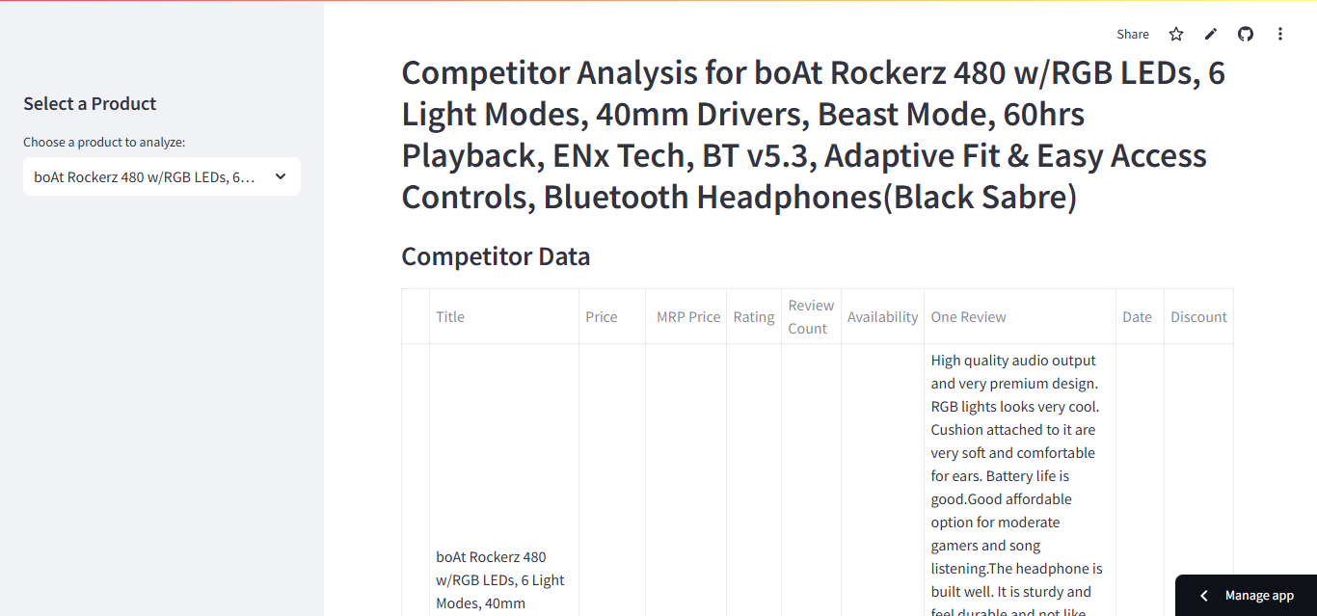
User Centric Design
Tailored Customer Insights:
Uses sentiment analysis to understand customer emotions, preferences, and pain points, ensuring strategies align with their needs and expectations.
Personalized Pricing Strategies:
Forecasts competitor trends and customer behavior to offer pricing and promotions that resonate with the target audience, enhancing customer satisfaction.
Real-Time Responsiveness:
Continuously adapts strategies based on dynamic customer feedback and market trends, fostering a responsive and customer-focused approach.

Slide 9
AI- Powered Process
START
Request Handling
Data Scraping
Sentiment Analysis
ML Based Price Prediction
Time Series forecasting
AI-Generated Strategic Insights
Visualization & Report Generation
Slack/Email Notifications
END
Sentiment Analysis for Customer Insights
Predictive Pricing with ARIMA & RandomForest Models
AI-Generated Strategic Recommendations

Slide 10

AI & ML Models Used and Their Roles
DistilBERT (NLP Model) → Sentiment analysis on customer reviews.
Random Forest Regressor → Predicts competitor pricing strategies.
ARIMA (Time-Series Model) → Forecasts future discount trends.
Llama 3 / OpenAI GPT → Generates strategic business insights.
K-Means Clustering → Segments products based on pricing patterns.

Slide 11


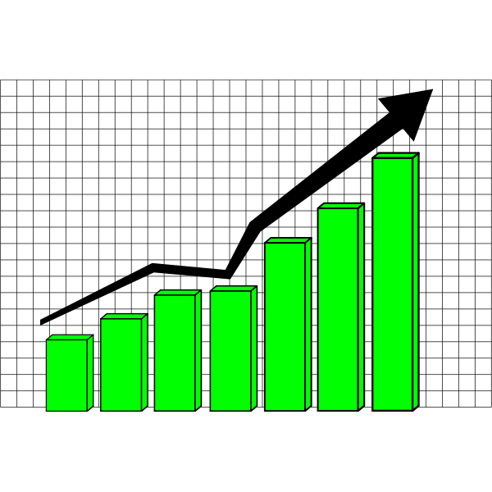
Real World Application
E-Commerce Competitive Pricing Optimization
Retail Business Intelligence & Promotions
AI-Driven Customer Sentiment & Product Strategy
Competitive Pricing and Promotion Optimization for Online Retailers
Benefits
Increased sales by offering competitive discounts at the right time.
Improved customer satisfaction by addressing key sentiment trends in reviews.
Enhanced market positioning by proactively responding to competitor pricing strategies.

Slide 12

Scaling the Vision
Advanced AI & Automation: Implement cutting-edge AI models for dynamic pricing, real-time market analysis, and personalized promotions to scale decision-making.
Global Market Expansion: Adapt pricing strategies for different regions by integrating localized consumer behavior insights, currency fluctuations, and regional competition data.
Robust Data Infrastructure: Scale data processing capabilities with cloud-based solutions, ensuring seamless handling of large datasets and high-speed analytics.
Cross-Platform Integration: Expand compatibility with major e-commerce platforms, ERP systems, and digital marketing tools to create a unified, scalable pricing strategy.

Slide 13

Conclusion
Scaling the vision for competitive pricing and promotion optimization enables businesses to stay ahead in dynamic markets. By leveraging AI, global insights, robust data infrastructure, and seamless integrations, companies can achieve sustainable growth, enhance customer experiences, and maximize profitability.
Key Benefits & Impact
Enhanced Decision-Making: AI-driven insights ensure data-backed pricing and promotional strategies, leading to improved accuracy and efficiency.
Increased Market Reach: Adapting strategies for different regions allows businesses to expand globally while maintaining competitiveness.
Higher Revenue & Customer Engagement: Personalized promotions and optimized pricing increase sales, customer retention, and brand loyalty, driving long-term profitability.

Slide 14

THANK YOU

